Slide 1
Lighting and Shading

Slide 2
Outline
Lighting
Lighting models
  Ambient
  Diffuse
  Specular
Surface Rendering Methods
Ray-Tracing

Slide 3
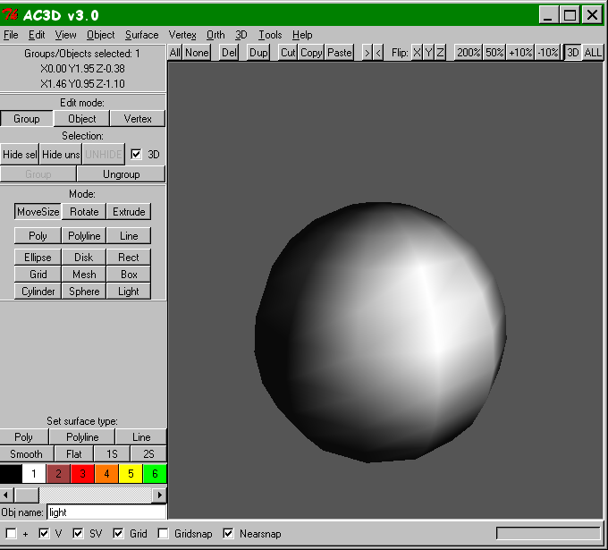
“Lighting”
Two components:
  Lighting Model or Shading Model - how to calculate the intensity at a point on the surface
  Surface Rendering Method - How to calculate the intensity at each pixel

Slide 4



Illumination - the transport of light from a source to a point via direct and indirect paths
Lighting - computing the luminous intensity for a specified 3D point, given a viewpoint
Shading - assigning colors to pixels
Illumination Models:
  Empirical - approximations to observed light properties
  Physically based - applying physics properties of light and its interactions with matter

Slide 5
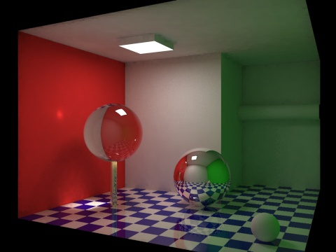
The lighting problem…
Global illumination – the transport of light within a scene.

Slide 6
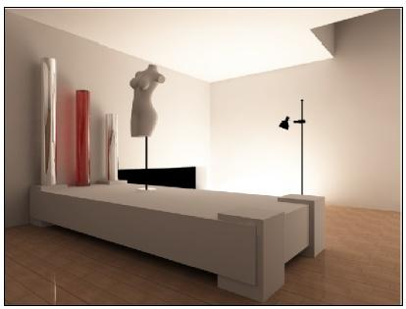
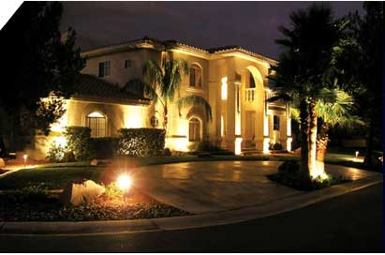
Two components
Light Source Properties
  Color (Wavelength(s) of light)
  Shape
  Direction
Object Properties
  Material
  Geometry
  Absorption

Slide 7
Light Source Properties
Color
  the light has one wavelength
Shape
  point light source - approximate the light source as a 3D point in space. Light rays emanate in all directions.
    good for small light sources (compared to the scene)
    far away light sources

Slide 8


Distributed Lights
Light Source Shape ….

Slide 9



Light Source Direction
In computer graphics, usually lights are treated as rays emanating from a source. The direction of these rays can either be:
  Omni-directional (point light source)
  Directional (spotlights)

Slide 10
Light Position
Specify the position of a light one of two ways, with an x, y, and z coordinate.
  These lights are called positional lights
Q: Are there types of lights that we can simplify?
A: Consider sun. If a light is significantly far away, we can represent the light with only a direction vector. These are called directional lights.

Slide 11
Contributions from lights
Breakdown what a light does to an object into three different components. This APPROXIMATES what a light does. To actually compute the rays is too expensive to do in real-time.
  Light at a pixel from a light = Ambient + Diffuse + Specular contributions.
  I_{light} = I_{ambient} + I_{diffuse} + I_{specular}

Slide 12
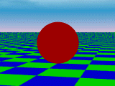
Ambient Term - Background Light
The ambient term is a HACK!
It represents the approximate contribution of the light to the general scene, regardless of location of light and object
Indirect reflections that are too complex to completely and accurately compute
I_{ambient} = color

Slide 13
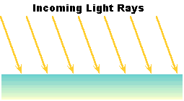
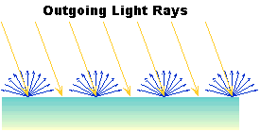
Diffuse Term
Contribution that a light has on the surface, regardless of viewing direction.
Diffuse surfaces, on a microscopic level, are very rough. This means that a ray of light coming in has an equal chance of being reflected in any direction.

Slide 14
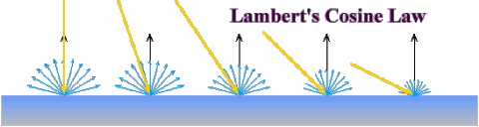
Lambert’s Cosine Law
Diffuse surfaces follow Lambert’s Cosine Law
Lambert’s Cosine Law - reflected energy from a small surface area in a particular direction is proportional to the cosine of the angle between that direction and the surface normal.
surface area and # of rays

Slide 15
Diffuse Term
To determine how much of a diffuse contribution a light supplies to the surface, we need the surface normal and the direction on the incoming ray
What is the angle between these two vectors?
I_{diffuse} = k_{d}I_{light}cosθ = k_{d}I_{light}(N . L)
I_{light} = diffuse (intensity) of light
k_{d} [0..1] = surface diffuse reflectivity
What CS are L and N in?

Slide 16
Example
What are the possible values for theta (and thus the dot product?)

Slide 17
Specular Reflection
Specular contribution can be thought of as the “shiny highlight” of a plastic object.
On a microscopic level, the surface is very smooth. Almost all light is reflected.
Viewing Direction
Normal of the Surface

Slide 18
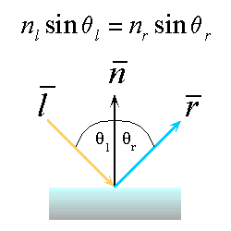
Snell’s Law
Specular reflection applies Snell’s Law.
  The incoming ray, the surface normal, and the reflected ray all lie in a common plane.
  The angle that the reflected ray forms with the surface normal is determined by the angle that the incoming ray forms with the surface normal, and the relative speeds of light of the mediums in which the incident and reflected rays propagate according to:
  We assume θ_{l} = θ_{r}

Slide 19
Snell’s Law is for IDEAL surfaces
The amount of light reflected at different angles.
N
R
L
θ
V

Slide 20
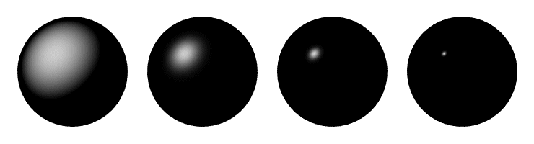
Different for shiny vs. dull objects

Slide 21
Snell’s Law is for IDEAL surfaces
Amount of light reflected at different angles.
N
R
L
θ
θ
V
φ

Slide 22
Phong Model
Phong Reflection Model
An approximation is setting the intensity of specular reflection proportional to (cos φ)^{shininess}
What are the possible values of cos φ?
What does the value of shininess mean?
How do we represent shinny or dull surfaces using the Phong model?
What is the real thing we probably SHOULD do?
I_{specular} = k_{s}I_{light} (cos φ)^{shininess} = k_{s}I_{light} (V.R)^{shininess}

Slide 23
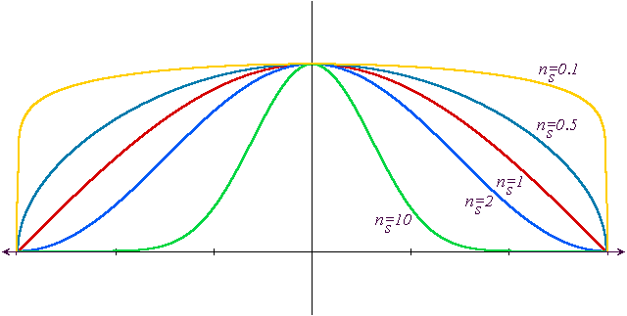
Effect of the shininess value

Slide 24
How do compute R?
N*(N.L)
R+L=2N(N.L)
R = 2N(N.L)-L
L
N
R
N(N.L)
θ
V
L
φ

Slide 25
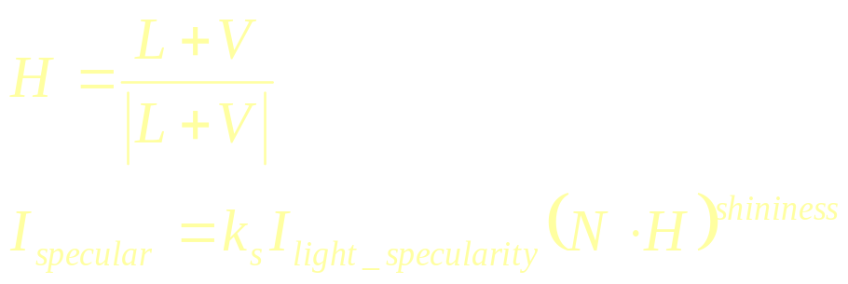
Simplify this
Instead of R, we compute halfway between L and V.
this vector the halfway vector, H.
H
N
R
θ
V
L
φ

Slide 26
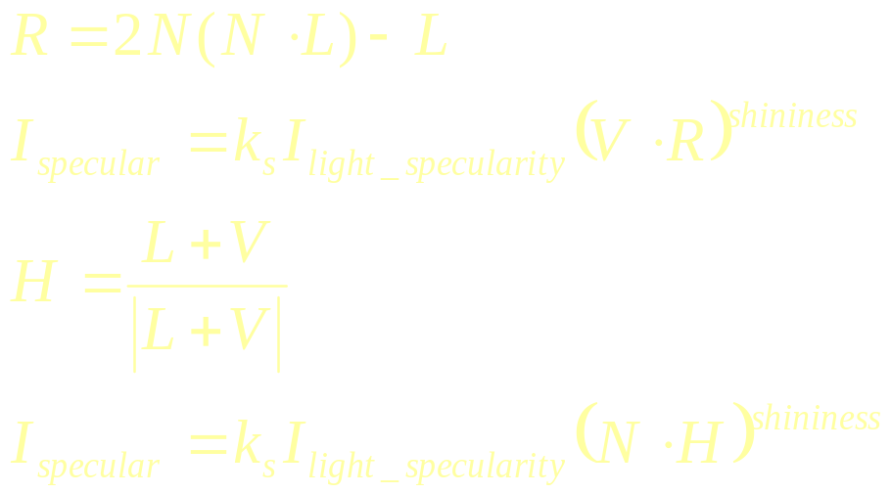
Compare
H
N
R
Q: Which vectors stay constant when viewpoint is far away?
A: V and L vectors -> H
θ
V
L
φ

Slide 27
Combining the terms
Ambient - the combination of light reflections from various surfaces to produce a uniform illumination. Background light.
Diffuse - uniform light scattering of light rays on a surface. Proportional to the “amount of light” that hits the surface. Depends on the surface normal and light vector.
Sepecular - light that gets reflected. Depends on the light ray, the viewing angle, and the surface normal.

Slide 28
Ambient + Diffuse + Specular

Slide 29
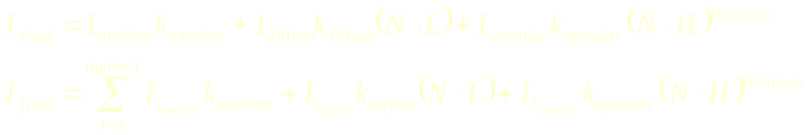
Lighting Equation
N
I_{lambient} = light source l’s ambient component
I_{ldiffuse} = light source l’s diffuse component
I_{lspecular} = light source l’s specular component
k_{ambient} = surface material ambient reflectivity
k_{diffuse} = surface material diffuse reflectivity
k_{specular} = surface material specular reflectivity
shininess = specular reflection parameter (1 -> dull, 100+ -> very shiny)
R
L
θ
V

Slide 30
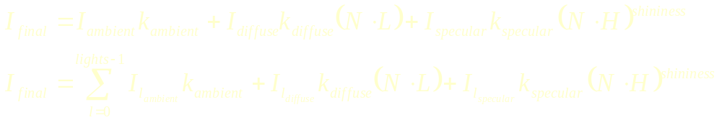
Clamping & Spotlights
N
R
L
θ
V

Slide 31
How would we light a green cube?
N
R
L
θ
V

Slide 32
Attenuation
Factor yet to take into account is that a light source contributes a higher incident intensity to closer surfaces.
The energy from a point light source falls off proportional to 1/d².

Slide 33
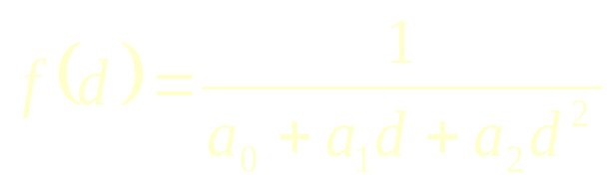
What would attenuation do for:
Actually, using only 1/d², makes it difficult to correctly light things. Think if d=1 and d=2. Why?
Remember, we are approximating things. Lighting model is too simple AND most lights are not point sources.

Slide 34
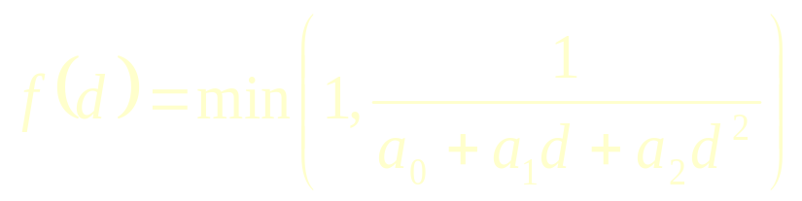
Subtleties
What’s wrong with:
What’s a good fix?

Slide 35
Full Illumination Model

Slide 36
Lights in OpenGL
1. glEnable(GL_LIGHTING);
2. Set up Light properties
  glLightf(…)
3. Set up Material properties
  glMaterial(…)

Slide 37

Shading

Slide 38
Shading
Shading is how we “color” a triangle.
Constant Shading
Gouraud Shading
Phong Shading

Slide 39
Constant Shading
Constant Intensity or Flat Shading
One color for the entire triangle
Fast
Good for some objects

Slide 40
Gouraud Shading
Intensity Interpolation Shading
Calculate lighting at the vertices. Then interpolate the colors as you scan convert

Slide 41




Gouraud Shading
Relatively fast, only do three calculations
No sudden intensity changes

Slide 42
Phong Shading
Interpolate the normal, since that is the information that represents the “curvature”
Linearly interpolate the vertex normals. For each pixel, as you scan convert, calculate the lighting per pixel.
True “per pixel” lighting

Slide 43
Shading Techniques
Constant Shading
  Calculate one lighting calculation (pick a vertex) per triangle
  Color the entire triangle the same color
Gouraud Shading
  Calculate three lighting calculations (the vertices) per triangle
  Linearly interpolate the colors as you scan convert
Phong Shading
  While you scan convert, linearly interpolate the normals.
  With the interpolated normal at each pixel, calculate the lighting at each pixel

